Slide 1
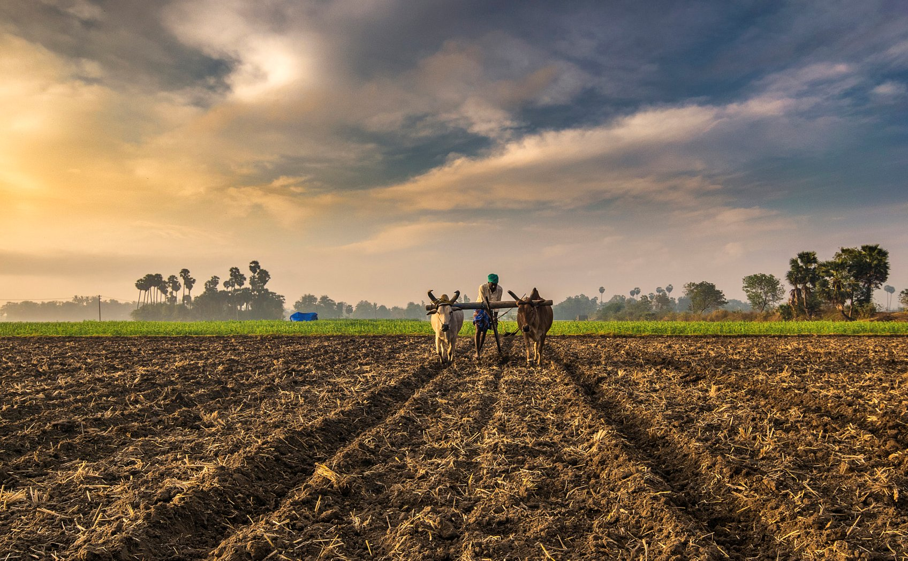
AI for Agriculture
Enter the Agri world!
Integrated Farm Assist Platform

Slide 2


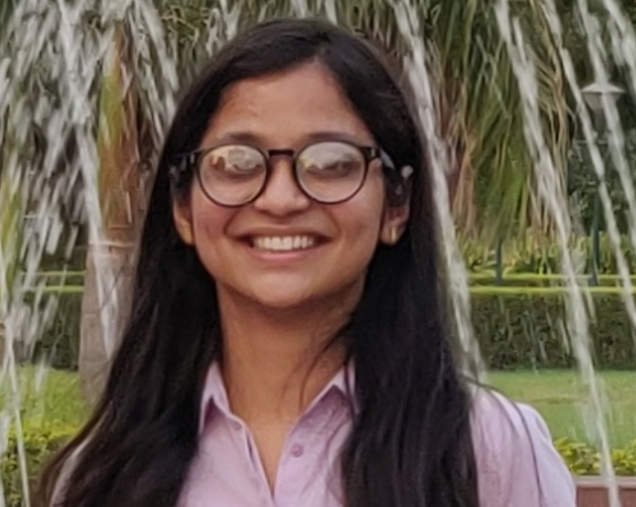



Our Team
Manan Arora
ML Engineer and Data Engineer
Saif
Product Development
Jaya Palewar
Data Analyst
Bharatdeep Maan
DevOps Engineer
Anmol Dureha
Hustler and Tool Optimizer
Pranati Balodia
Product Development

Slide 3
Big Picture: Agriculture Industry in lndia
India has the 10th largest arable land resources in the world.
The average income of a farmer household at current prices is Rs 96,703 (US$ 1,505.27)
Industry growth has been volatile over the past decade, ranging from 5.8% in 2005-06 to 0.4% in 2009-10 and -0.2% in 2014-15
Agricultural sector employs nearly half of the total workforce, but it contributes to 17.5% of the GDP​
Total agricultural exports from India grew at a CAGR of 16.45 per cent over FY10-18 to reach US$ 38.21 billion in FY18.
Notes:
Quant fact

Slide 4
Problem : Information Asymmetry for the Farmers in India
Unaware of Best Practices
Unequitable access to latest technological innovations and detailed domain level information
Increasing Climate Uncertainty
Changing weather patterns, ecology changes and soil uncertainties disrupting yield
Crop loss of 15.7% annually due to pest attacks ~US$ 36 billion
Climate change could reduce farm incomes by 15-18%
Resource Constraints
Due to constraints like size of land, lack of irrigation, electricity and low-cost finance
85% of operational land holdings are less than 2 hectares and account for 45% of total cropped area
Lack of Market/ Awareness
Insufficient knowledge of market economics and price movements
Incomes of all farmers declined at 1.36% per annum between
2011-12 and 2015-16
Limitations for Data Driven Decisions
Lack of mechanism for assessing decisions based on data and forecasting trends
Most data is scattered on different databases and even offline
Notes:
Pest Attack
MSP Issues
Climate Loss floods vagerah
Finance Figures/ Efficiency Figures

Slide 5
Project Initial Plan
04a
01a
Tailored Alerts
Speech and Text Based Query Input from Farmers
03
Connection to Knowledge
Bank to Answer farmer queries on best practices
Toolkits:
Azure QnA
Data:
Secondary Sources
05
01b
Context Detection, Sematic Parsing, POS Tagging, Paraphrases
Models:
CNNs, RNNs & LSTMs
Toolkits:
Google Diaglogflow
Training Data:
KCC Data
02
Response to User
Collection of Feedback
Yield Predictions
Supplementary Information – User Geotag, Profile Information, Weather etc.
04b
Conversion of Speech to Text
Toolkits:
Amazon Transcribe
Azure Speech - Text
Indic NLP
Machine learning model to predict crop yield, give automatic alerts
Models:
Decision Trees, SVMs, ANN
Training Data:
Historical Data
Weather Data, Disease Data

Slide 6
Solution : Overview
Integrated Farm Assist
2
Image Based Disease Detection Service
Text Based Chatbot for Farmers to Answer their Queries
1A
1B
Nearest Mandi Pricing Information

Slide 7



Product Roadmap
Week 1
Week 2
Week 3
Week 4
Week 5
Week 6
Week 7
www
Data crawling
Data
Pre-processing
EDA
Design
Model Development and Training
Web-app Development
Testing and Deployment

Slide 8
Putting the Pieces Together - Datasets Used
Kissan Call Center Data
8 Largest Cotton and Wheat Producing States
Data Type: Text | Years 2015 and 2016
5.2 Million Records
Selenium Web crawling
Plant Village Data
Crowd AI Plant Disease Data
38 Classes , 14 Crops
55,261 Images
01
02
03
Mandi Pricing Data
All India for Mandi’ Price on each Day
Data Type: Numerical | Years: 2015+
5.8 Million Records
Selenium Web crawling
04
Maize Field Images
Maize images for Northern Leaf Blight diseases on Maize
18,222 Images | 105,735 Bounding Boxes
Other Datasets we Crawled but were unable to Utilise:
Soil Health Card Data – 1400 Records - Ajnala, Amritsar, Punjab
Disease Best Practises Data – Plantix Data – 555 rows

Slide 9
Exploratory Data Analysis – Kisan Call Centre Data
Cotton Data – Out of the 5.2 Million Records
05
2.3K
Attack of White Fly Queries
04
03
02
0.26M
Number of records of cotton
01
3K
Number of unique Queries in plant protection for cotton (after cleaning stop words, defined library, punctuations, stemming)
67K
Number of unique Queries in plant protection for cotton (unique geographic column)
120K
Number of Queries in Plant Protection category of cotton
5 Categories of Queries within cotton
- Plant Protection: 45%
- Weather: 10%
- Fertilizer Use and Availability: 8.6%
- Market Information: 8.5%
- Varieties: 8%

Slide 10
Exploratory Data Analysis – Kisan Call Centre Data
Wheat Data – Out of the 5.2 Million Records
05
2K
Number of Queries on zinc deficiency in wheat
04
03
02
0.36M
Number of records of Wheat
01
2.8K
Number of unique Queries in plant protection for cotton (after cleaning stop words, defined library, punctuations, stemming)
39K
Number of unique Queries in plant protection for wheat (unique geographic column)
68K
Number of Queries in Plant Protection category of wheat
5 Categories of Queries within cotton
- Plant Protection: 45%
- Weather: 10%
- Fertilizer Use and Availability: 8.6%
- Market Information: 8.5%
- Varieties: 8%

Slide 11
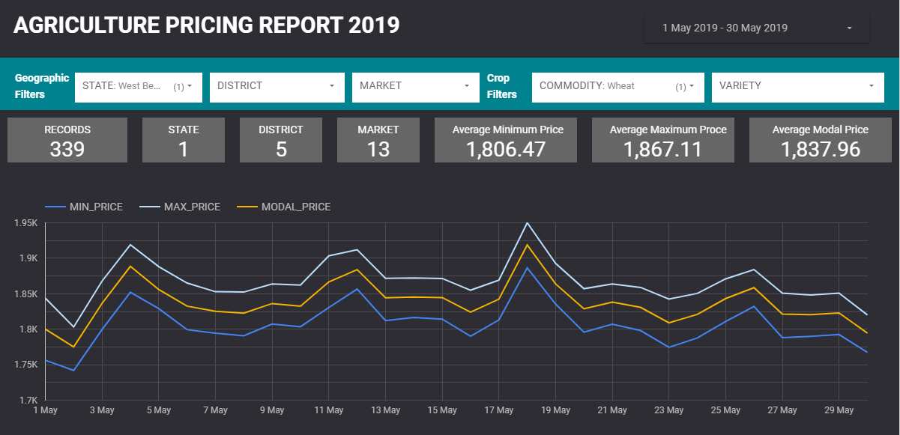
Exploratory Data Analysis – Pricing Data
Based on Google Big Query and Data Studio

Slide 12
Tested, Not Deployed: Chatbot with Rasa NLU
Team used several methods to pre-process KCC data for Chatbot mentioned below:
Tokenization, Lemmatization, Stemmers
Cosine Similarities
Using Latent Dirichlet allocation probabilistic model to find out similar questions within the dataset
Clustering the questions using the embedding’s (Word2Vec) and K-Means clustering algorithm
Generating entity examples using Chatito - Team used Chatito to create a knowledge base for the Chatbot. This was used for training.
Data preparation and format- For training data in rasa, we preferred markdown format over json format.
Intent- Intent name specified with list of questions under it.
Entity - It was specified inside the knowledge-based questions.
Pre-processing
Implementation Steps

Slide 13
Success, In Production: Chatbot with Dialogflow
Quick and easy to start building
Built on Google infrastructure
Easy to scale
Strong natural language understanding (NLU) capabilities
We used the knowledge base beta connector
‘Knowledge Connectors’ lets you add your content in csv or plain text format as a Knowledge Base to your Agent.
For a given user utterance, the Bot would then try to match it to the predefined intent, or a system generated intent based on its match to the text in the Knowledge Base.
Why Dialogflow?
Implementation Steps

Slide 14
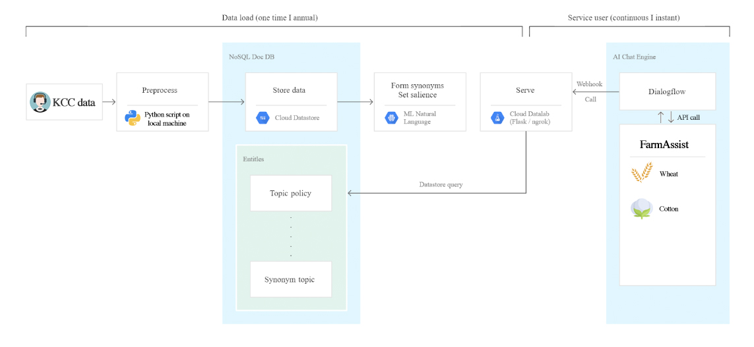
Solution Architecture
Dialogflow

Slide 15
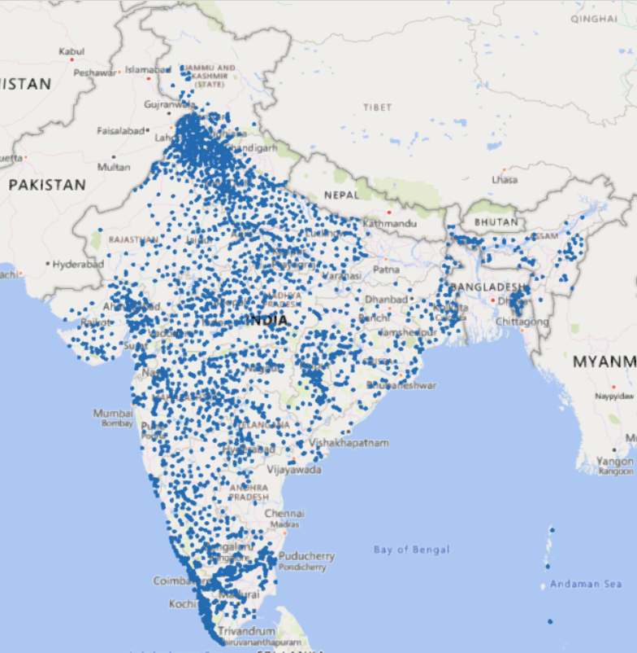
Success, In Production: Pricing Data
Data for all the crop varieties and commodities, from all markets was combined for 2019.
Latitude Longitude was derived using the Google Geocoding API for all the market
K-Nearest Neighbors algorithm was trained to form clusters using the Latitude and Longitude Data
Latitude Longitude is captured from the device and based on that the five closest Mandi price is displayed on the app.
Tools and Algorithms Used:
Google Geocoding Services (Maps Platform) KNN, Bootstrap Studio
Data from 2300 Local Markets Across India

Slide 16
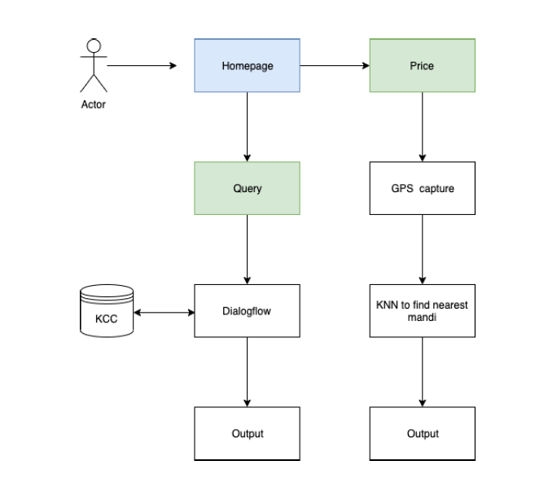
Solution User Architecture
Dialogflow

Slide 17
Demo – Component 1
End to End – Chatbot and Pricing Platform

Slide 18
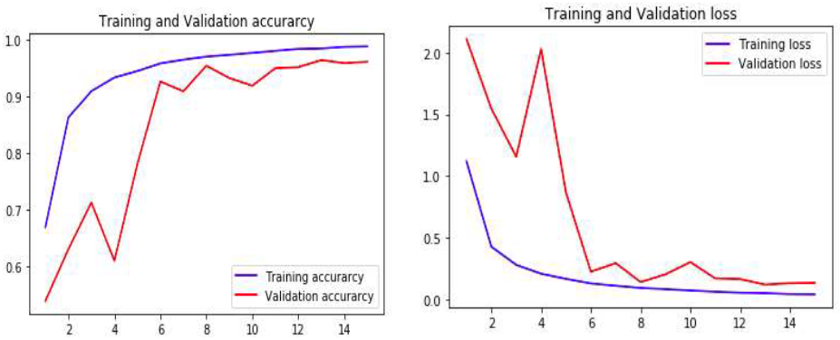
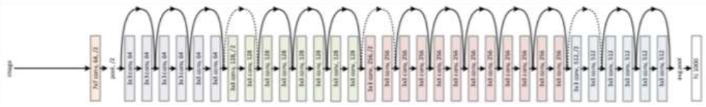
Testing Ground on Image Data: Plant Village Data
The model was trained for 15 Epochs with a validation split of 20% of the data
Training and Validation Accuracy
Training and Validation Loss
ResNet50 Architecture

Slide 19
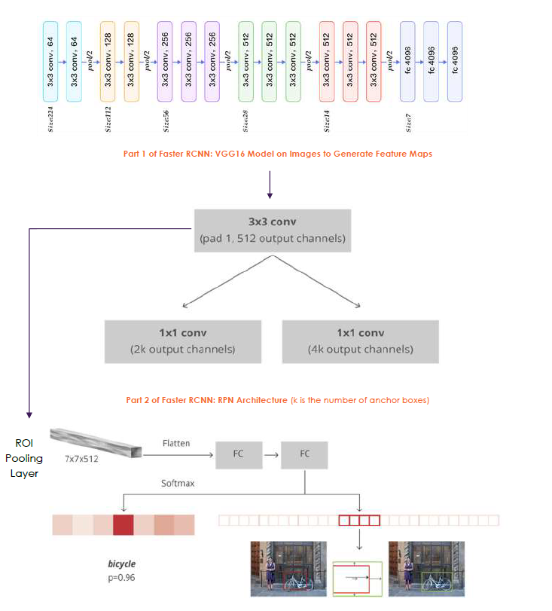
Maize Field Images: Northern Light Blight
Faster RCNN Model
VGG Layer: Pre- trained VGG 16 Model is applied to the image develop feature map
RPN Layer: Each point in feature map is considered as an anchor. We need to define specific ratios and sizes for each anchor
Then RPN is connected to Convolution Layer with 3*3 filter, 1 padding and 512 output channels.
Intermediate Output: Connected to 1*1 Fully Connected Layer - box classification and box regression
RoI Layer: ROI pooling is used for these proposed regions (ROIs). The output is 7x7x512.
Then, we flatten this layer with some fully connected layers.
Classifier Layer: The final step is a softmax function for classification and linear regression to fix the boxes’ location.

Slide 20
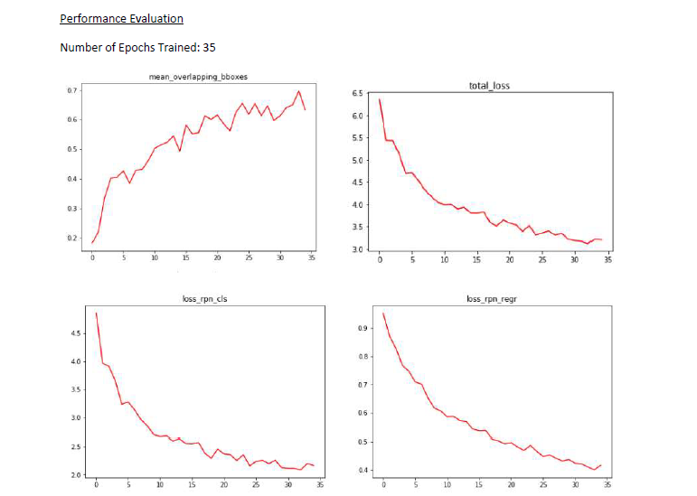
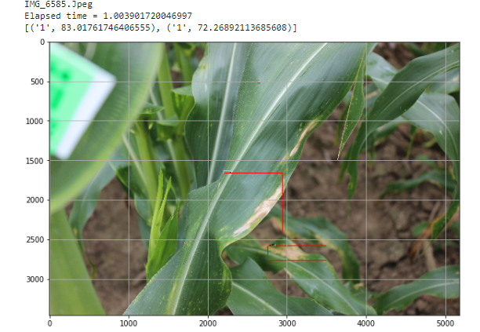
Real Model: Maize Field Images – Northern Light Blight
Train Data: 1462 Images – 6257 Bounding Boxes, 361 Images – 1442 Bounding Boxes
Performance Evaluation ( 35 Epochs)
Actual Images
Training Data: Mean Overlap of Bounding Boxes: 69.8% | Classification Accuracy: 79% | RPN Regression Loss: 2.2 | RPN Classification Loss: 0.401
Test Data : Mean Average Precision: 67.5%

Slide 21
Summarizing the Challenges
Struggled with Government Website Structure while crawling data, frequently server down
NLP Problems generally require a lot of manual intervention in terms of defining intents and entities
Rasa NLU: Memory Intensive, a lot of production related issues and no out of box integration
Dialogflow: Only high level customisations are possible.
Inability to deploy Speech to Text on Server – Problem caused by PyAydio
Navigating the complex ecosystem of cloud services, we chose Google Cloud Platform and struggled with multiple services it offers what to choose and what not to.
Ended up getting a billing of $150 over and above 600$ of Free credits on GCP. Mistakenly kept the Cloud SQL Instance on which dried up a lot of credits.
Smooth Seas Do No Make Skilful Sailors

Slide 22
Way Forward: How this can turn into an actual On - Ground Solution?
Add Support for Multiple India Languages in the Chatbot to ensure Usability
Add Better Speech to Text Compatibility for Indian Languages
Integrate Other Authentic Prescriptive sources that ca help
Integrate Additional information like Soil, Weather
Fetch Real Time Pricing Data from Government sources instead of the current static data
Collate a more comprehensive dataset for different crops and disease to train image model for detection
Strategic Partnerships: CABI India (Vinod Pandit, Director), Prof. Dharmendra Saraswat (Purdue University),
CropIn (Richa Hukumchand, R&D)
Launch as an Application for On Ground Usage

Slide 23
Thank You!

